Slide 1
Notes:
DON’T FORGET TO START DATABRICKS CLUSTER!!!!!

Slide 2
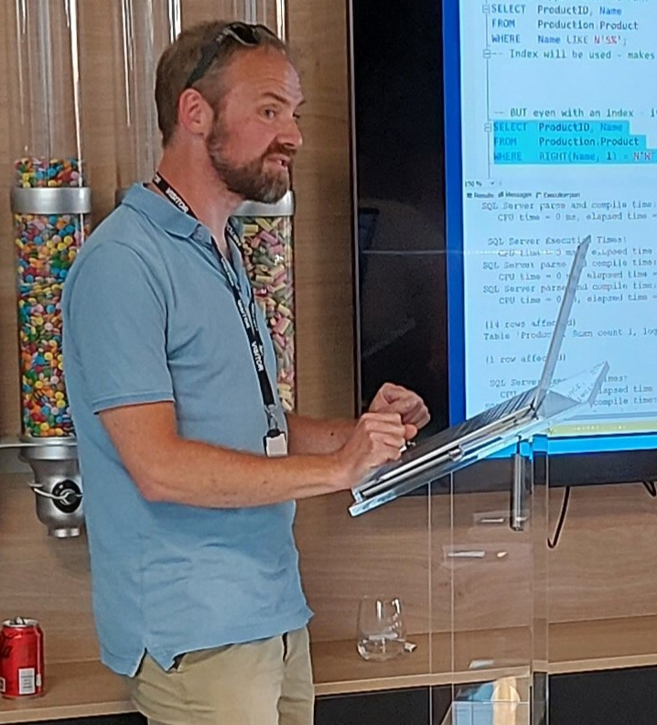

Phil Austin
Senior Consultant

Slide 3
Azure
Go to Azure.com
Click ‘Try Azure for free’
You will need:
An email address
A mobile phone
A credit/debit card – don’t worry you won’t be charged!
Choose United Kingdom or US region
$200 credit / 30 days
Some resources are free longer / permanently

Slide 4
Data engineering using your free credits
Resource group

Slide 5

Data engineering using your free credits
SQL Server
Resource group

Slide 6

Data engineering using your free credits
SQL Server
Data Factory
Resource group

Slide 7

Data engineering using your free credits
SQL Server
Data Factory
Storage Account
Resource group

Slide 8

Data engineering using your free credits
Res
SQL Server
Data Factory
Storage Account
Databricks
Resource group

Slide 9
VS Code
Free download
Very large number of plug-ins/extensions – most free

Slide 10
Azure CLI
Install by following links from: https://learn.microsoft.com/en-us/cli/azure/install-azure-cli
For VS Code:
Azure CLI Tools
Azure Developer CLI

Slide 11
Azure Portal

Slide 12
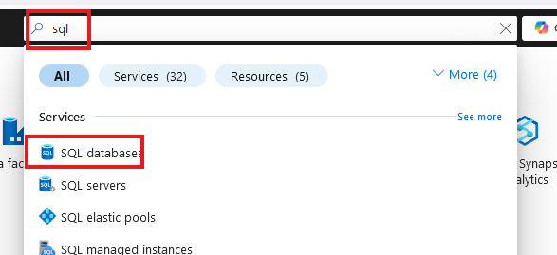
Create SQL database

Slide 13
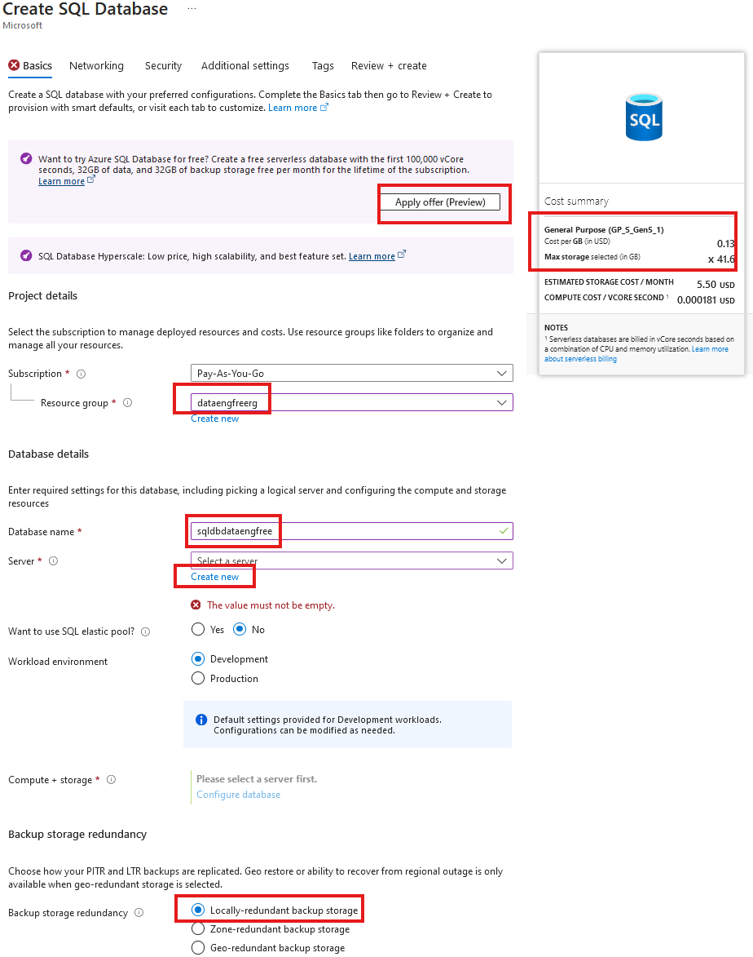
Create SQL database

Slide 14
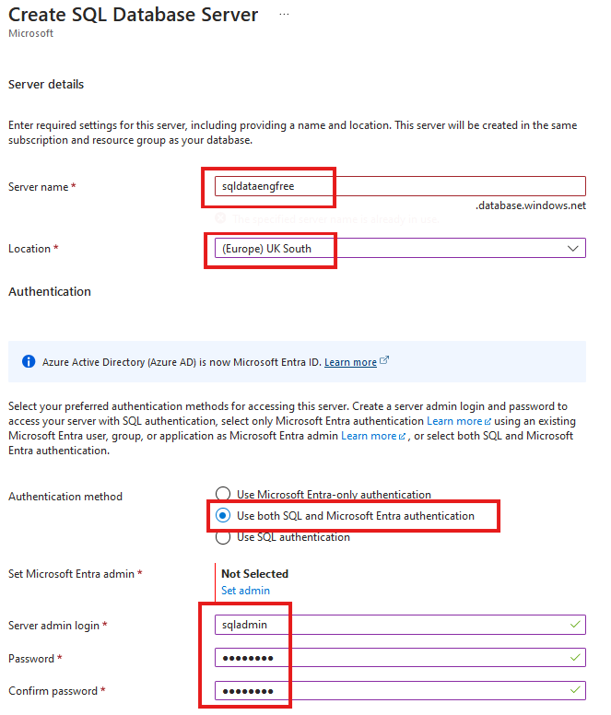
Create SQL database

Slide 15
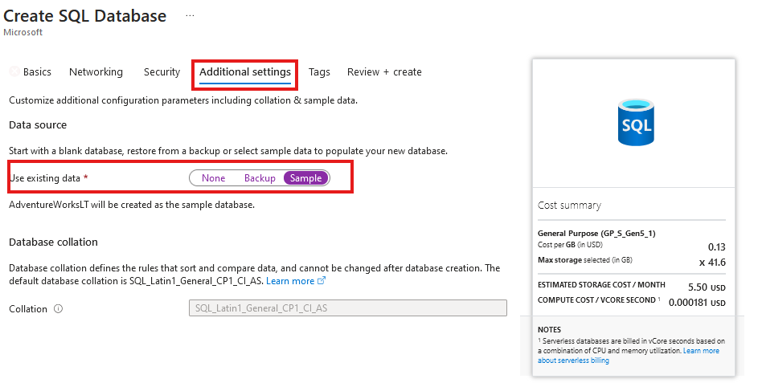
Create SQL database
Add sample data

Slide 16
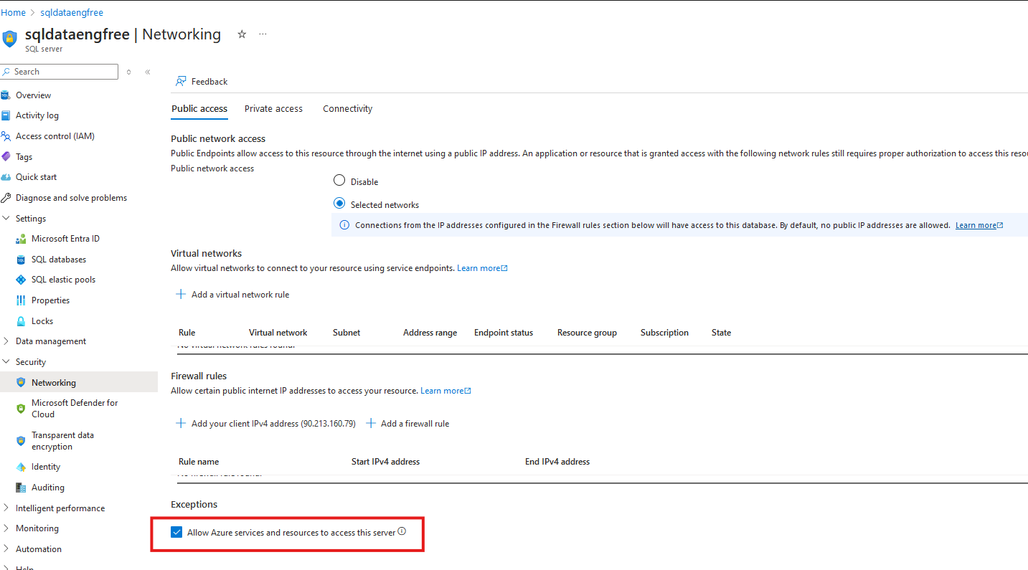

Slide 17
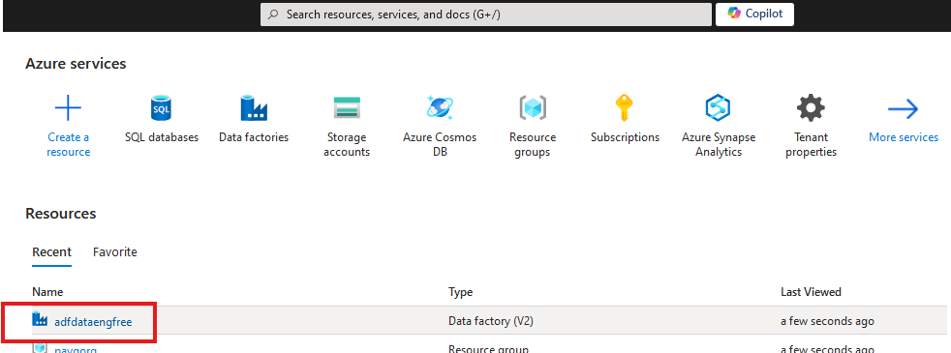


Slide 18
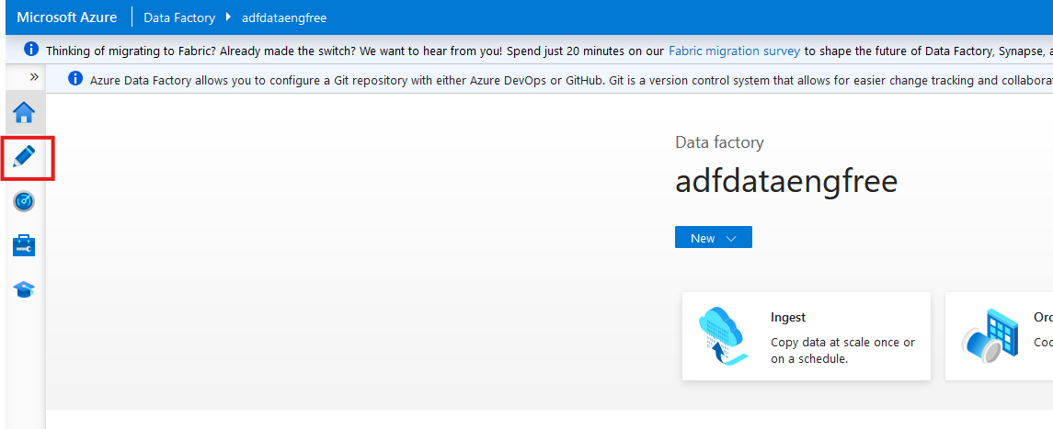

Slide 19
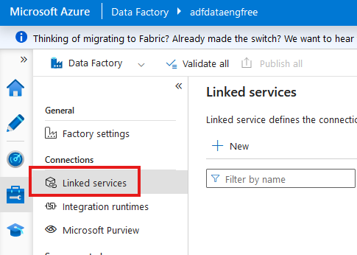

Slide 20
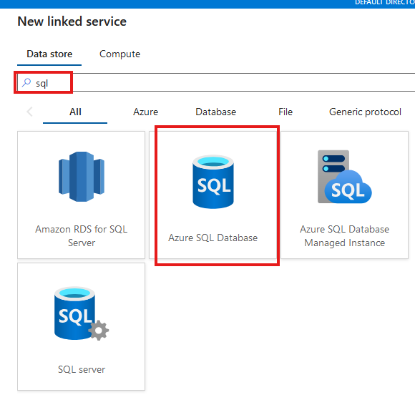

Slide 21
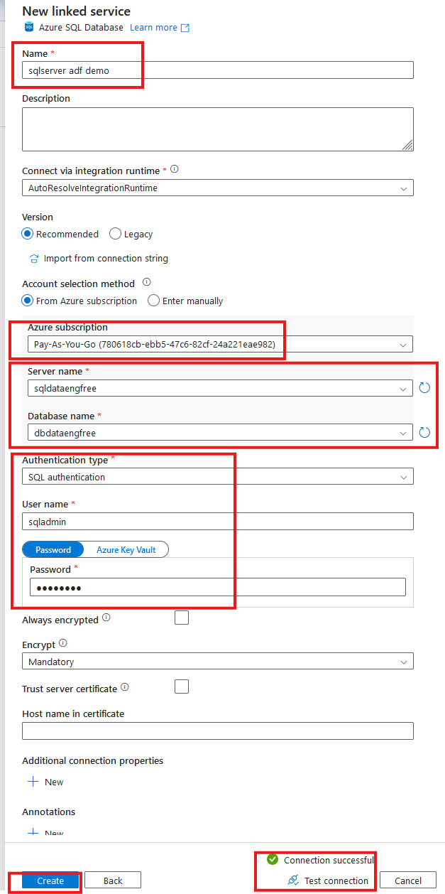

Slide 22
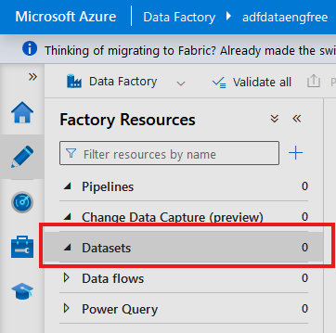
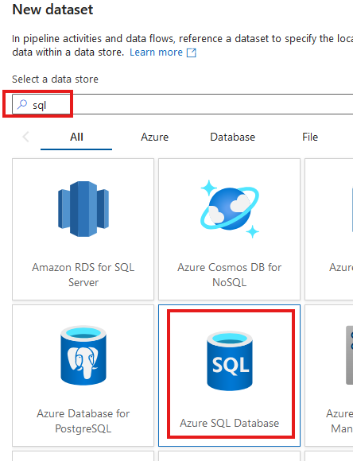

Slide 23
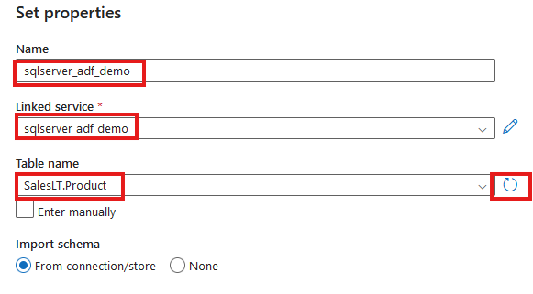

Slide 24
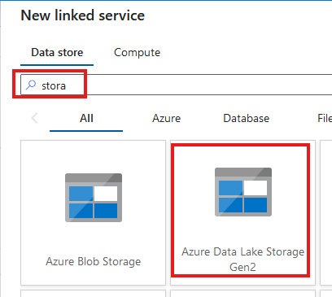
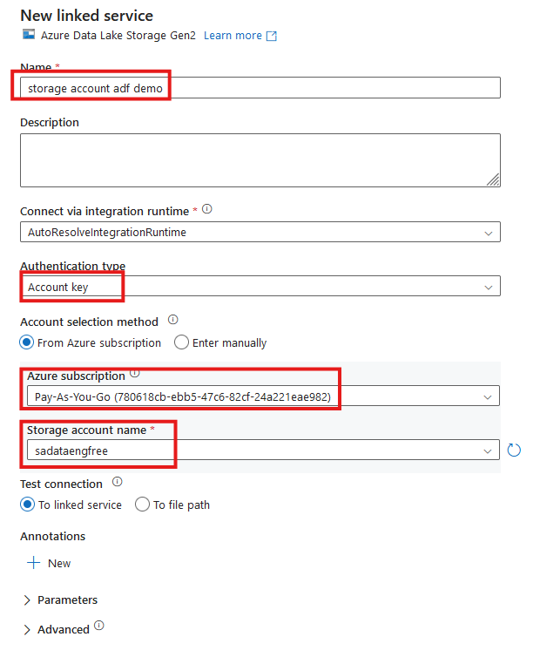


Slide 25
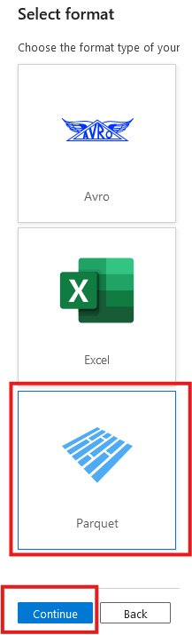
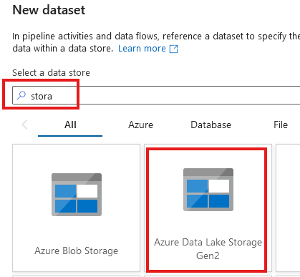

Slide 26
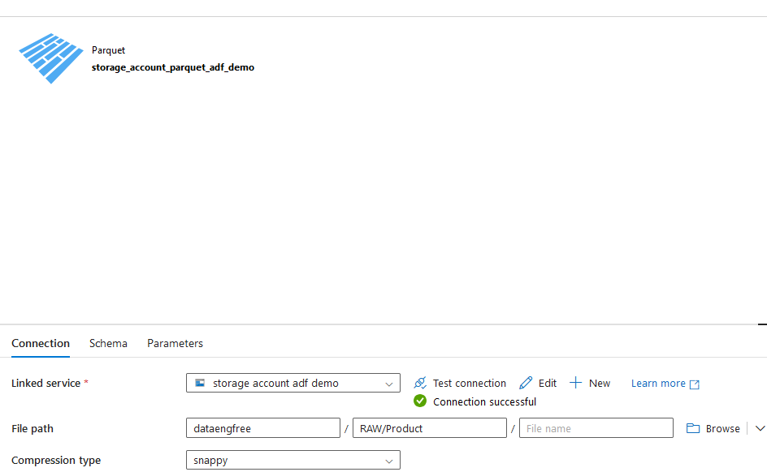

Slide 27
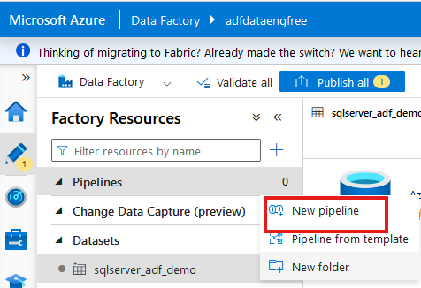
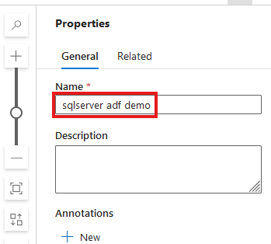

Slide 28
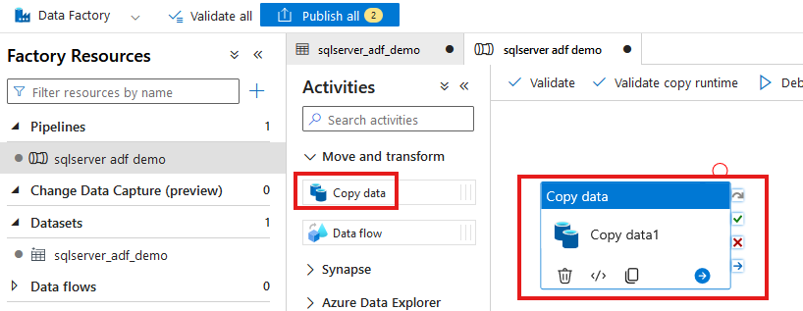

Slide 29
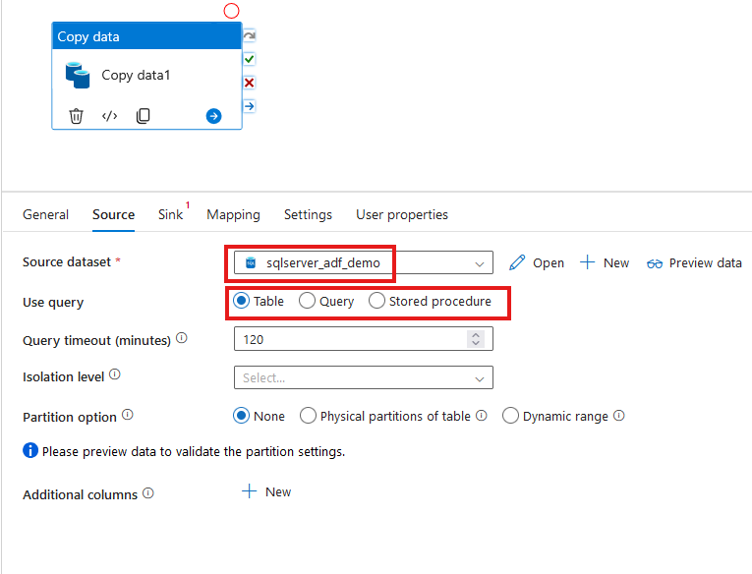

Slide 30
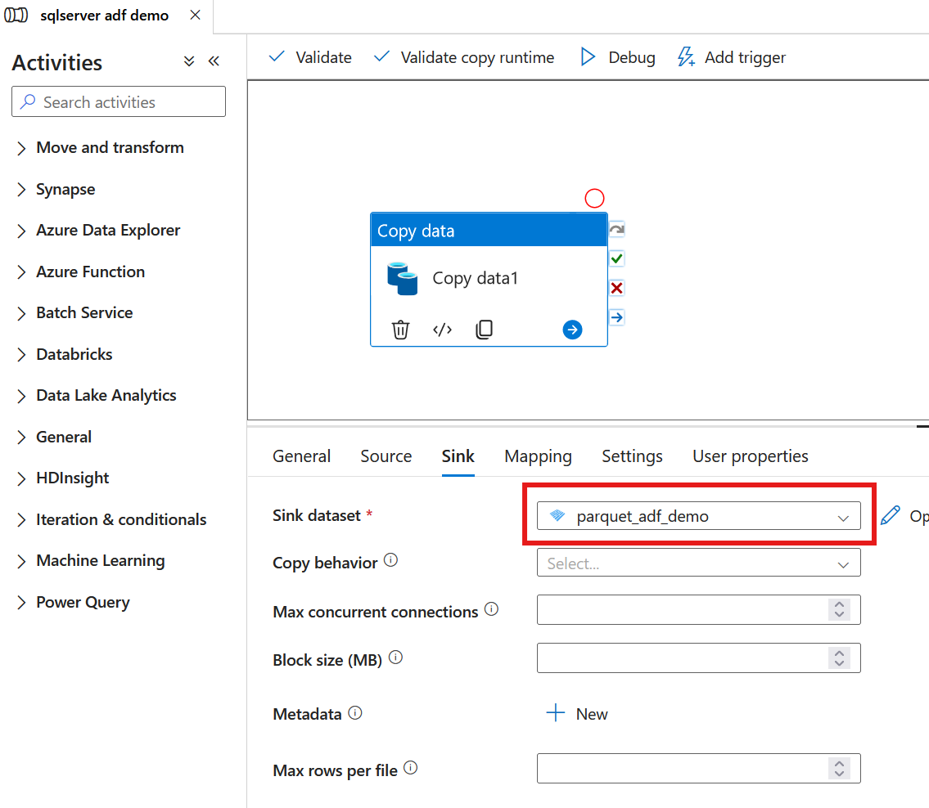

Slide 31
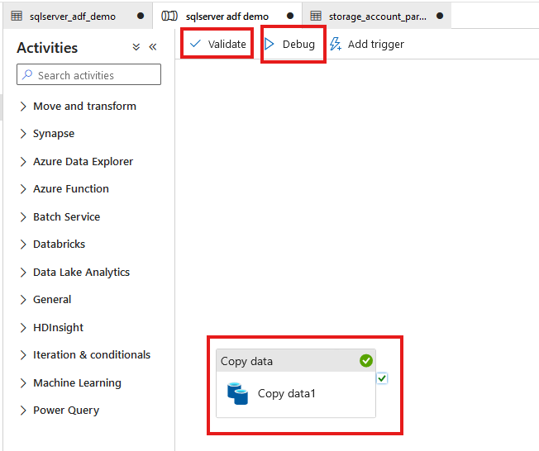

Slide 32
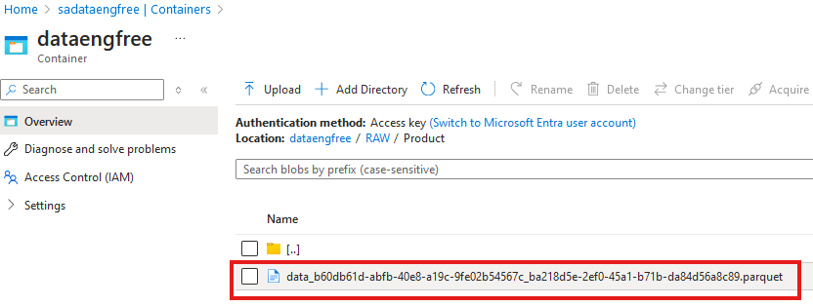

Slide 33
Azure CLI Part II

Slide 34
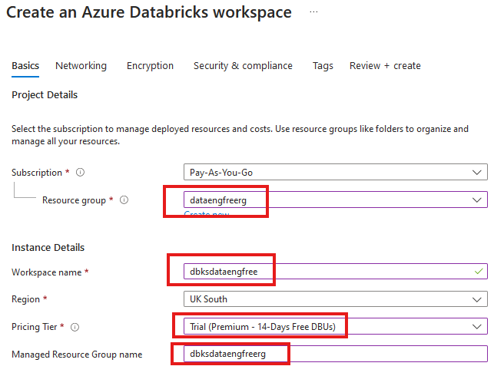


Slide 35
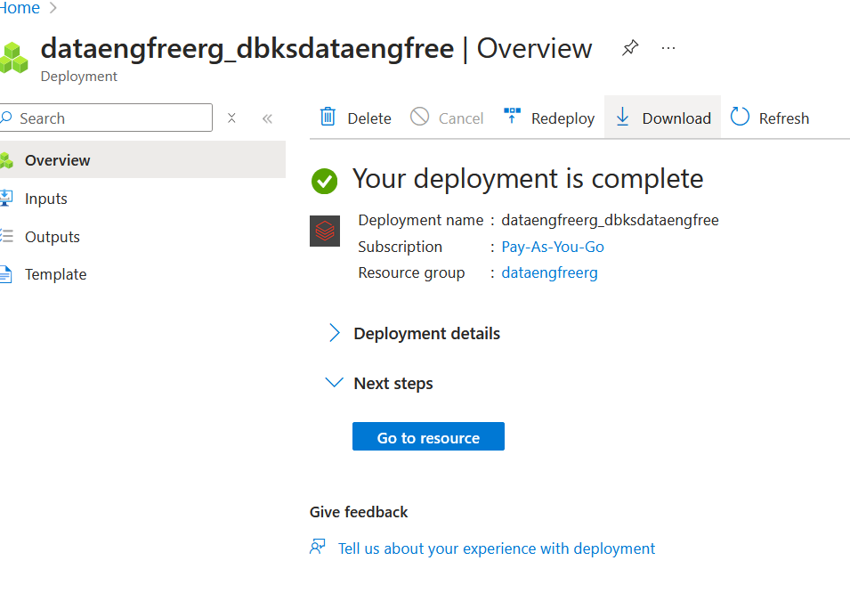

Slide 36
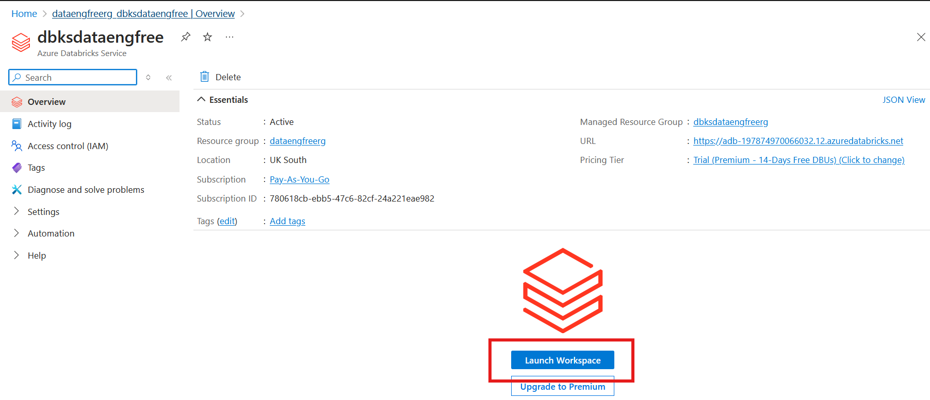

Slide 37
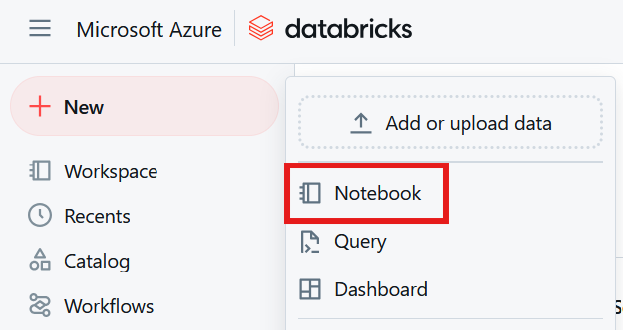

Slide 38
Databricks Demo

Slide 39
Data Engineering locally

Slide 40
Python
What is Python?

Slide 41
Python
What is Python?
Use Anaconda

Slide 42
Python
What is Python?
Use Anaconda
Use conda to create environment

Slide 43
Python
What is Python?
Use Anaconda
Use conda to create environment
Might need to enable Long Paths

Slide 44
Python
What is Python?
Use Anaconda
Use conda to create environment
Might need to enable Long Paths

Slide 45
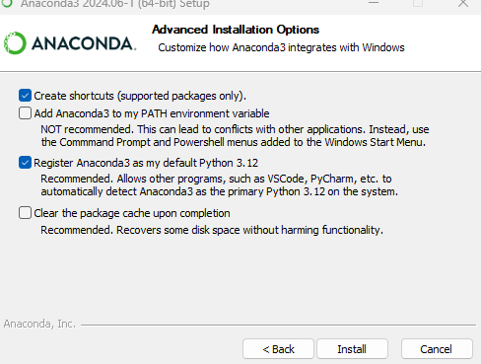
Anaconda install

Slide 46
Conda demo

Slide 47
Apache Spark
Spark

Slide 48
Apache Spark
Spark
PySpark

Slide 49
PySpark Pre-requisites
Install Java v17

Slide 50
PySpark Pre-requisites
Install Java v17
Set paths in environment variables
JAVA_HOME
PATH

Slide 51
PySpark Pre-requisites
Install Java v17
Set paths in environment variables
JAVA_HOME
PATH
Install Apache Spark

Slide 52
PySpark Pre-requisites
Install Java v17
Set paths in environment variables
JAVA_HOME
PATH
Install Apache Spark
Install winutils.exe

Slide 53
PySpark Pre-requisites
Install Java v17
Set paths in environment variables
JAVA_HOME
PATH
Install Apache Spark
Install winutils.exe
Create virtual environment

Slide 54
PySpark Pre-requisites
Install Java v17
Set paths in environment variables
JAVA_HOME
PATH
Install Apache Spark v3.5.3
Install winutils.exe
Create virtual environment
Instructions: https://sparkbyexamples.com/pyspark-tutorial/

Slide 55
PySpark Demo
Uses VS Code
Notes:
PySpark validation
Web UI
VS Code
- to run Jupiter notebooks needs ipykernel installed
- from vscode run conda install -n dataengforfree_env ipykernel
- copy python.exe > python3.exe
Visualisation?

Slide 56
PySpark Demo
Uses VS Code
Needs Jupyter package installed
conda install jupyter
pip install jupyter
Notes:
PySpark validation
Web UI
VS Code
- to run Jupiter notebooks needs ipykernel installed
- from vscode run conda install -n dataengforfree_env ipykernel
- copy python.exe > python3.exe
Visualisation?

Slide 57
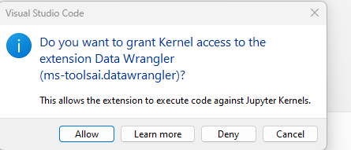

Slide 58
Follow-up Resources
Repo: https://github.com/phil-a10/Talks/tree/main/Data%20Engineering%20Using%20Free%20Tools
Microsoft Learn: https://learn.microsoft.com/en-us/training/career-paths/data-engineer
PySpark instructions: https://sparkbyexamples.com/pyspark-tutorial/
Kimball: https://www.kimballgroup.com/
Downloads
Azure CLI: https://learn.microsoft.com/en-us/cli/azure/install-azure-cli
VS Code
Java
Apache Spark
Winutils

Slide 59
END

Slide 60
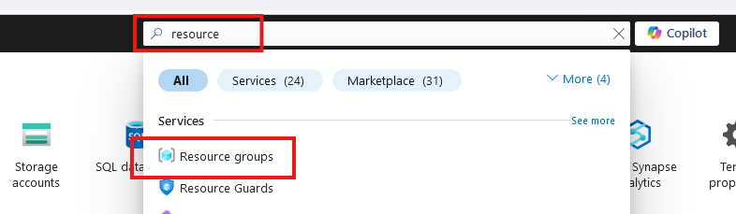
Create Resource Group

Slide 61
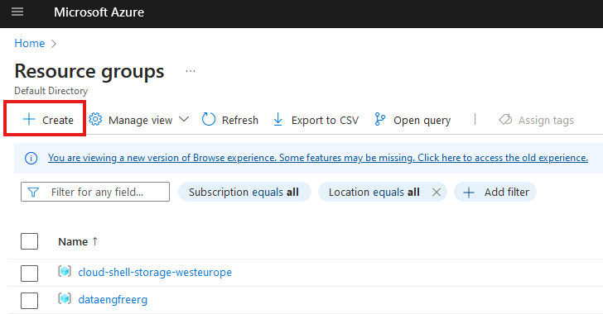
Create Resource Group

Slide 62
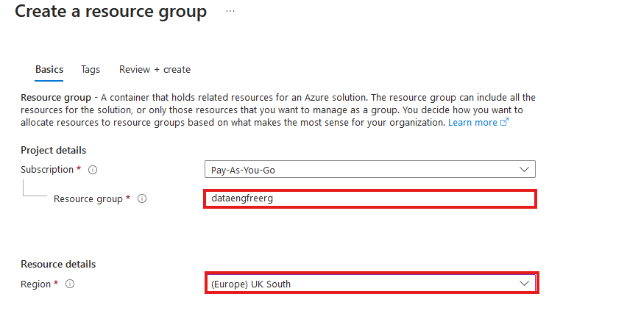
Create Resource Group

Slide 63
Azure CLI Demo

Slide 64
Create storage account
Create in same region as RG
Primary service is ADLS Gen 2
Primary workload Big Data Analytics
Performance: Standard
Redundancy: LRS
Add container > RAW directory

Slide 65
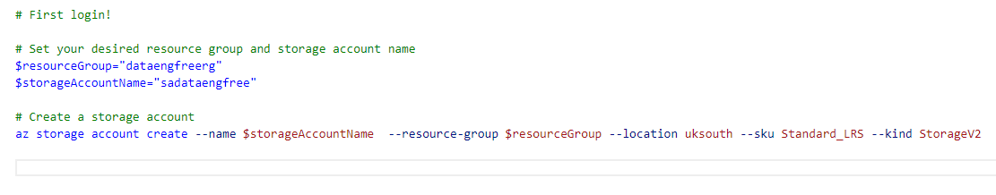
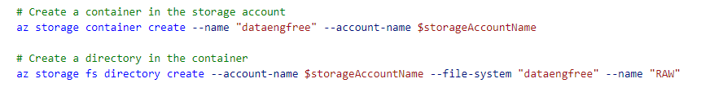
Create storage account

Slide 66
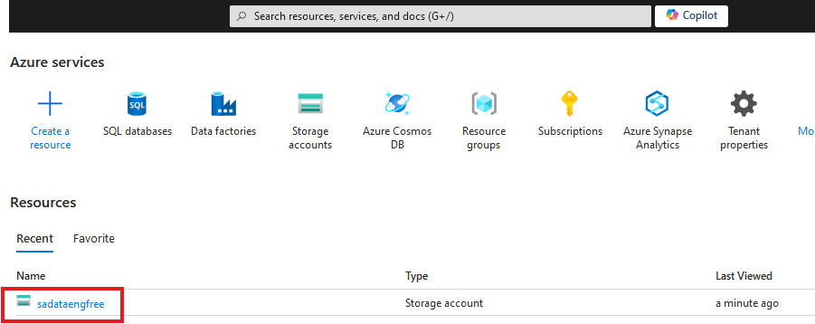

Slide 67
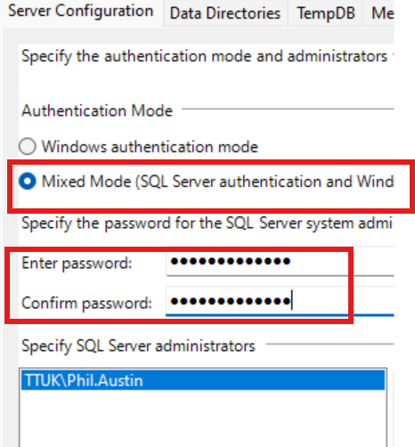

Slide 68
Create Azure Data Factory
Create in same region as RG

Slide 69
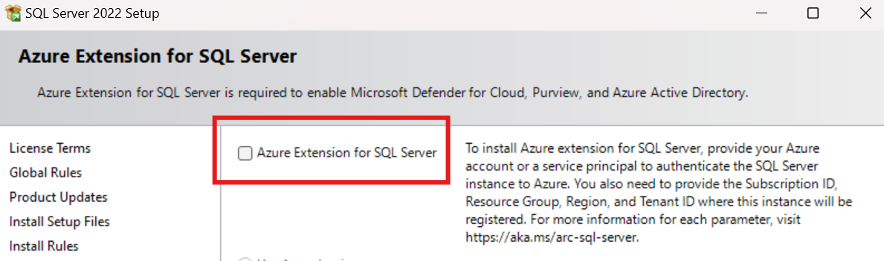
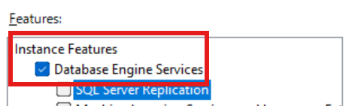
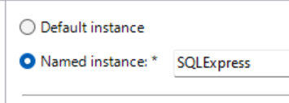

Slide 70
Data & Databases
Concepts to Learn: Data types, databases (SQL and NoSQL), data structures.
Tools/Resources:
Azure SQL Database - free tier available
Cosmos DB: Explore NoSQL databases with a limited free tier on Azure.

Slide 71
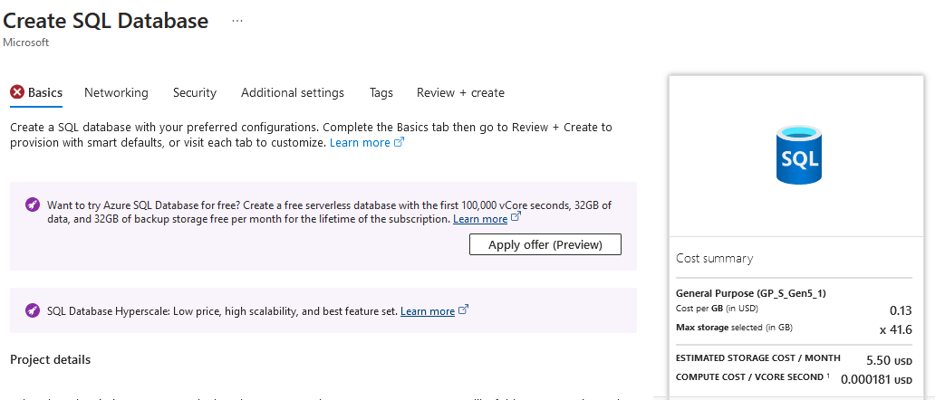

Slide 72
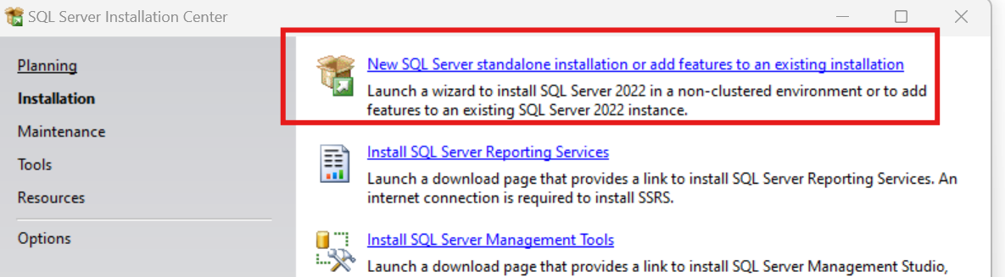
SQL Express!
https://www.microsoft.com/en-us/download/details.aspx?id=104781&lc=1033

Slide 73
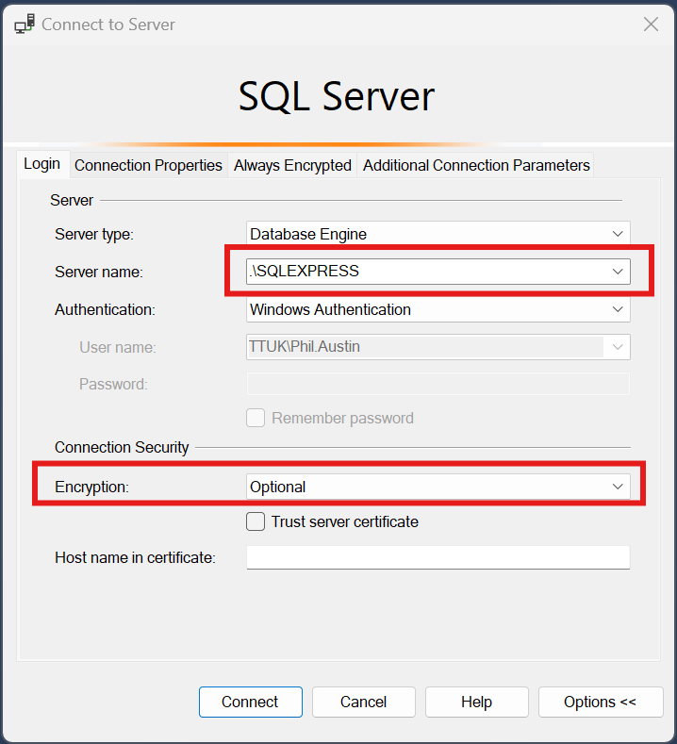

Slide 74
Download JDBC driver: https://repo1.maven.org/maven2/com/microsoft/azure/spark-mssql-connector_2.12/1.2.0/spark-mssql-connector_2.12-1.2.0.jar
Copy jar file to anaconda jars folder

Slide 75
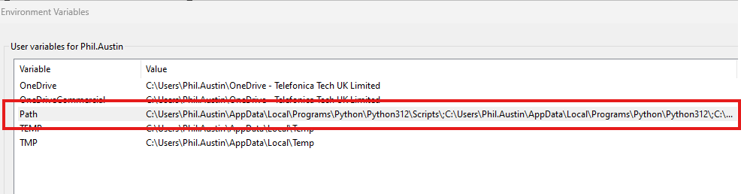
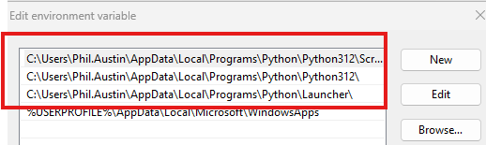
Python pre-reqs

Slide 76
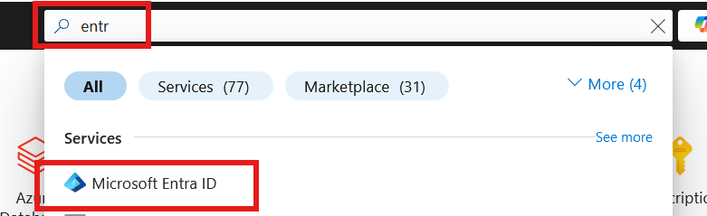
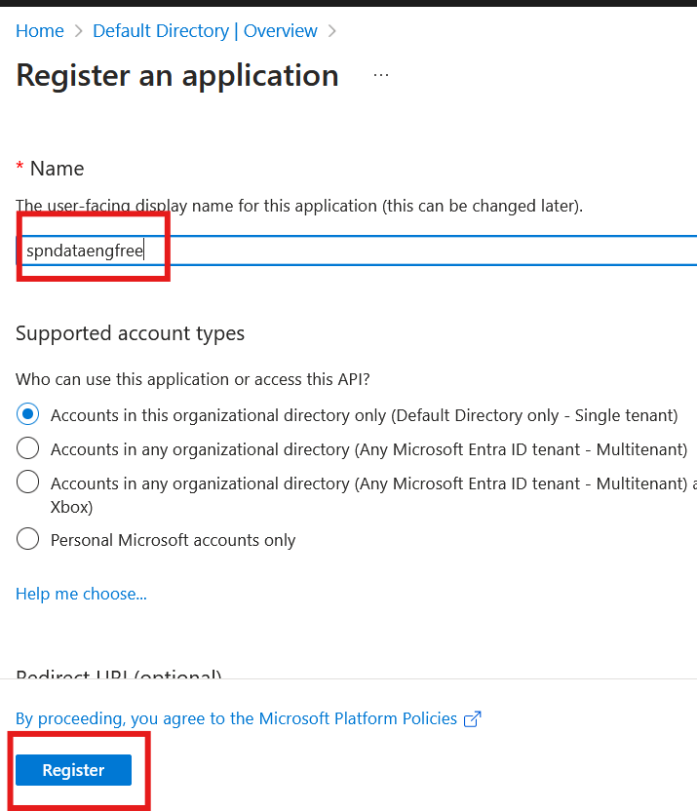

Slide 77
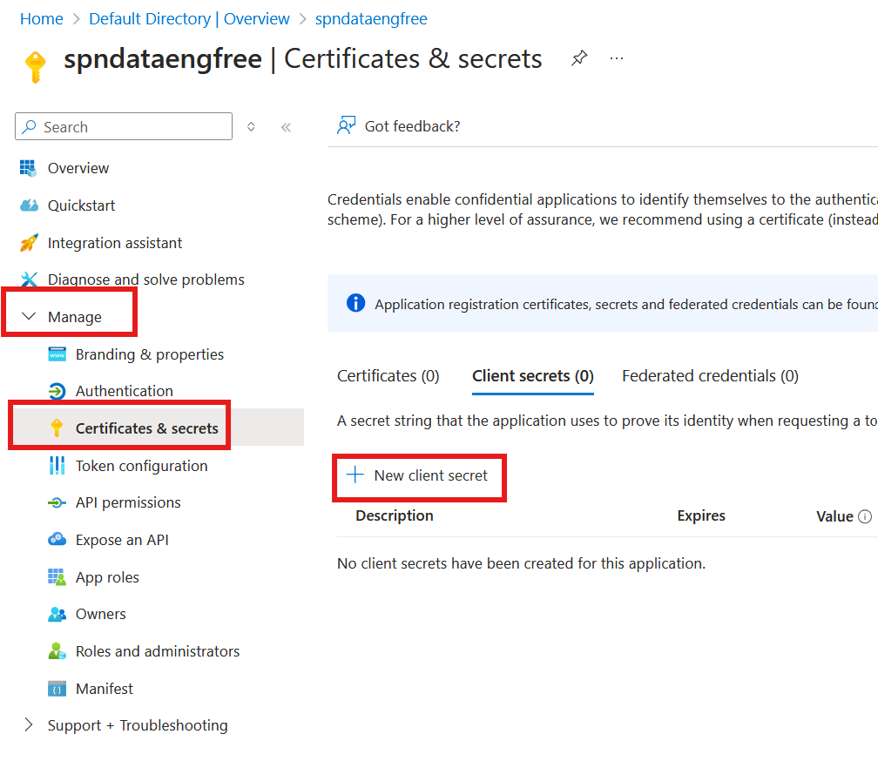


Slide 78



Slide 79


Slide 80

Create storage account

Slide 81

Create storage account

Slide 82

Create storage account

Slide 83



Slide 84


Create Azure Data Factory (ADF)

Slide 85
Create Azure Data Factory (ADF)

Slide 86

Create Azure Data Factory (ADF)

Slide 87


Slide 88


Slide 89


Slide 91
PySpark

